Slide 1
E-COMMERCE DELIVERY ANALYTICS
Power BI Dashboard
Data model • Calculated columns • DAX measures • Chart mapping • Page layout
Source: E-commerce_Delivery_Shipping_Data_2026 • 50,000 orders • 6 report pages

Slide 2
Objective
Why this dashboard exists and what it needs to answer
1
Delivery performance
Track the split between on-time and late orders, and how it trends month to month.
DASHBOARD SNAPSHOT
50,000
2
Cost efficiency
Relate order value, shipping cost and distance to spot which shipping methods are efficient.
Total Orders
56.32%
3
Operational scorecards
Compare carriers and warehouses side-by-side on speed, cost and reliability.
Late Delivery Rate
43.68%
On-Time Delivery Rate
4
Geographic patterns
Surface which countries and distance bands concentrate the most late deliveries.
3.37
Avg Customer Rating
$6.03M
Total Shipping Cost
E-COMMERCE DELIVERY ANALYTICS • DASHBOARD DESIGN
2

Slide 3
From Raw Data to Dashboard
The build sequence this data followed
30
9
26
6
Source Columns
Calculated Columns
DAX Measures
Dashboard Pages
Raw fact table → cleaned & bucketed with calculated columns → summarized with DAX measures → assembled into 6 report pages
Table: E-commerce_Delivery_Shipping_Data_2026 — 19 of the 30 source columns are referenced directly in this report's visuals: (Order_id, Order_date, Delivery_status, Carrier, Warehouse_city / _id, Shipping_method, Customer_country / _city / _id / _segment, Package_size, Weather_condition, Distance_km, Order_value_usd, Shipping_cost_usd, Actual_delivery_days, Promised_delivery_days, Delivery_attempts, Late_delivery)
E-COMMERCE DELIVERY ANALYTICS • DASHBOARD DESIGN
3

Slide 4
Calculated Columns
4 of 9 — the ones referenced by at least one chart across the report
Column | Purpose | Logic
Order Value Band | Buckets each order into a price tier | Order values are grouped into predefined ranges to understand the distribution of orders by value:
Delivery Performance Band | Groups each order's delivery outcome | Buckets orders (e.g. on-time / mildly late / very late) for the performance-band column chart
Distance Band | Groups shipping distance into ranges | Used to compare the late-delivery rate across short vs. long routes
SLA Met Flag | Marks whether an order met its SLA | Counted (non-null) per shipping method to gauge SLA compliance
E-COMMERCE DELIVERY ANALYTICS • DASHBOARD DESIGN
4

Slide 5
DAX Measures — Volume, Cost & Delivery
9 of 26 measures — the first half referenced by the KPI cards and charts
Measure | Purpose
Total Orders | Headline count of all orders — the report's core denominator
Late Delivery Rate % | Share of orders delivered after the promised date
On-Time Delivery Rate % | Complement of late rate — share delivered on or before promise
Average Customer Rating | Mean customer satisfaction score across orders
Total Shipping Cost | Sum of shipping cost across all orders
Total Order Value | Sum of order value across all orders
Average Shipping Cost | Mean shipping cost per order
Average Delivery delays | Average number of days late, among delayed orders
Average Delivery Attempts | Average number of delivery attempts per order
E-COMMERCE DELIVERY ANALYTICS • DASHBOARD DESIGN
5

Slide 6
DAX Measures — Operations & Drill-Through
8 more of 26 — used for scorecards and order-level detail (9 measures not shown aren't used in any visual)
Measure | Purpose
Average Distance | Average shipping distance per order
Avg Processing Hrs | Average warehouse processing time before an order dispatches
Late Index Rate | Weighted lateness score used to rank carriers
Repeat delivery Attempts % | Share of orders needing more than one delivery attempt
Promised Delivery Days | Average promised delivery window
Actual Delivery days | Average actual delivery time
Shipping Cost | Per-order shipping cost, shown in the order drill-through
Rating | Per-order customer rating, shown in the order drill-through
E-COMMERCE DELIVERY ANALYTICS • DASHBOARD DESIGN
6

Slide 7
Chart Usage Mapping
Which visual carries each insight, and why
Insight | Chart | Why
Headline KPIs | Card visuals | Instant read on scale and performance before drilling in
Late-delivery trend by month | Line chart | Shows seasonality and direction over time
Order mix by delivery status | Donut chart | Compares parts of a whole at a glance
Distance vs. delivery time vs. lateness | Scatter chart | Reveals whether longer routes drive delays, three variables at once
Order value vs. shipping cost by method | Scatter (bubble) chart | Compares cost efficiency across shipping methods, sized by distance
Carrier / warehouse scorecards | Table | Dense side-by-side comparison across many metrics
Late rate by country | Filled map | Shows geographic concentration of late deliveries
Late rate by distance band | Bar chart | Compares lateness across distance buckets
Order-level detail | Pivot table / drill-through | Lets a user inspect any single order
E-COMMERCE DELIVERY ANALYTICS • DASHBOARD DESIGN
7

Slide 8
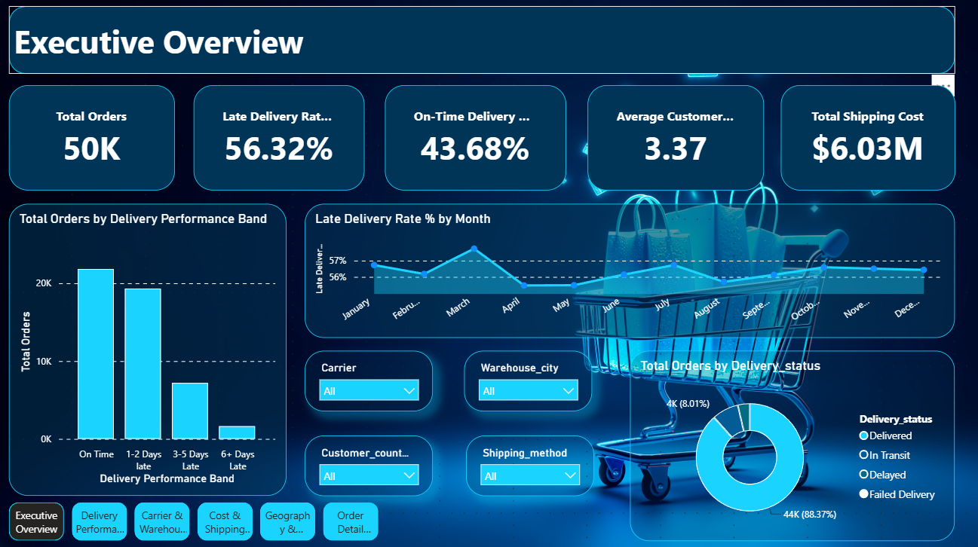
Executive Overview
PAGE 1 • Carrier, Warehouse, Method, Country filters
50K
56.32%
43.68%
3.37
$6.03M
Total Orders
Late Delivery Rate
On-Time Delivery
Avg Customer Rating
Total Shipping Cost
LINE
DONUT
COLUMN
Late Delivery Rate % by Month
Total Orders by Delivery Status
Total Orders by Delivery Performance Band
Tracks how the late-delivery rate moves month over month, to catch seasonal spikes.
Splits the full order base by outcome (delivered, in transit, late, etc.).
Compares order volume across performance tiers.
8

Slide 9
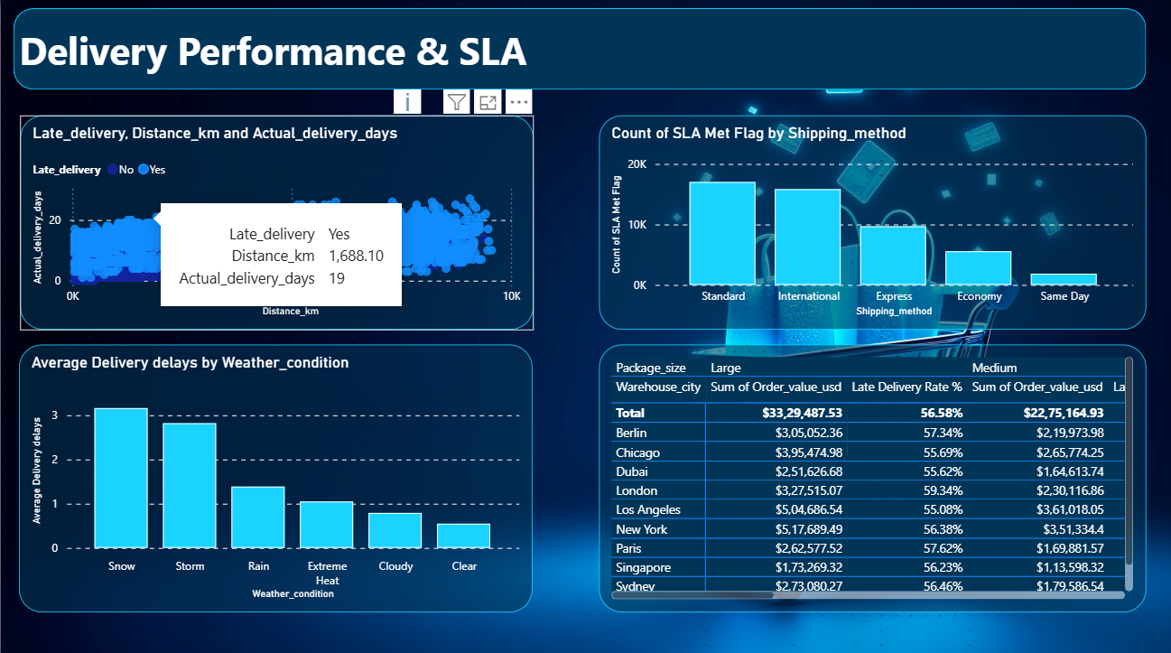
Delivery Performance & SLA
PAGE 2 • How well SLAs are being kept, and where they slip
COLUMN
SCATTER
SLA Met Count by Shipping Method
Distance vs. Actual Delivery Days (by Late flag)
Benchmarks SLA compliance across Economy, Express, International, Same Day and Standard.
Tests whether longer routes are what's actually driving late deliveries.
CLUSTER COL
Warehouse_city × Package_size
Average Delivery Delay by Weather Condition
Order value (sum) • Late Delivery Rate %
Compares average lateness across weather conditions at time of shipment.
9

Slide 10
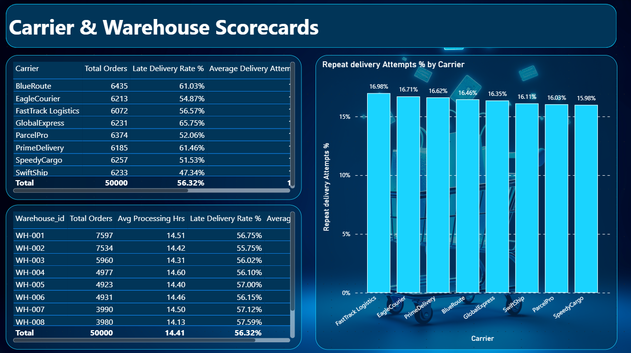
Carrier & Warehouse Scorecards
PAGE 3 • Operational comparison across carriers and warehouses
Carrier Scorecard
Warehouse Scorecard
Total Orders • Late Delivery Rate % • Avg Delivery delays • Late Index Rate • Avg Delivery Attempts
Warehouse_id • Total Orders • Avg Processing Hrs • Late Delivery Rate % • Average Distance
CLUSTER COL
Repeat Delivery Attempts % by Carrier
Flags which carriers most often need a second (or third) delivery attempt.
10

Slide 11
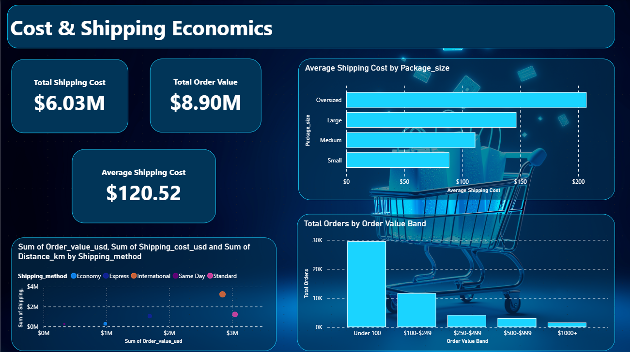
Cost & Shipping Economics
PAGE 4 • Where cost, order value and distance line up — or don't
$6.03M
$8.90M
$120.52
Total Shipping Cost
Total Order Value
Average Shipping Cost
SCATTER
CLUSTER COL
BAR
Order Value vs. Shipping Cost by Method
Total Orders by Order Value Band
Average Shipping Cost by Package Size
Bubble size = distance, color = shipping method — the outlier bubble (International) costs and travels the most.
Shows where most orders sit on the price spectrum.
Compares average cost across package-size tiers.
11

Slide 12
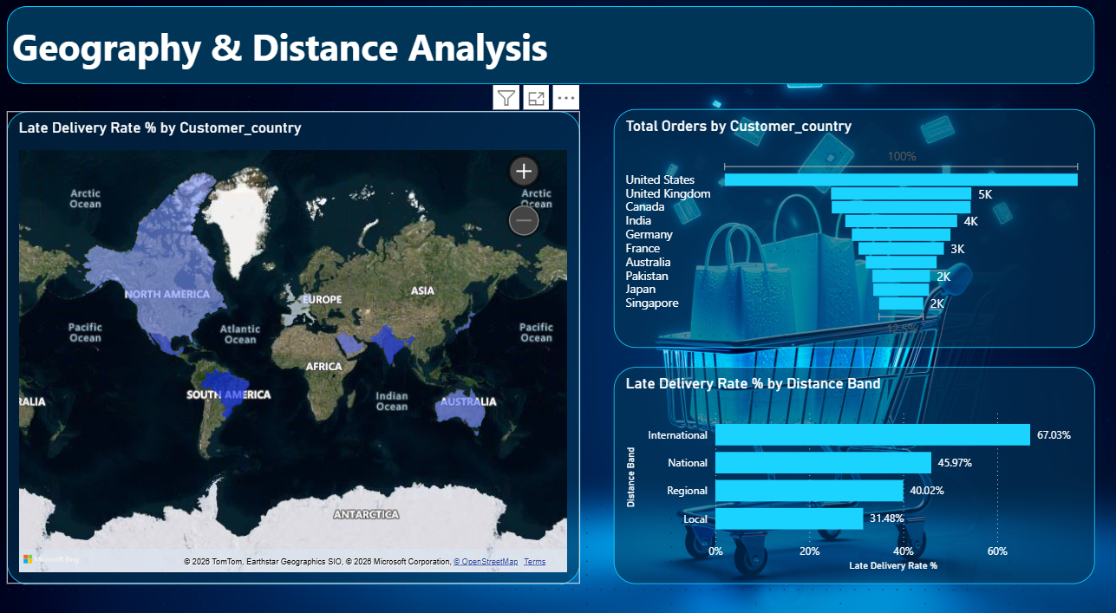
Geography & Distance Analysis
PAGE 5 • Where late deliveries concentrate
FILLED MAP
FUNNEL
Late Delivery Rate % by Customer Country
Total Orders by Customer Country
Choropleth shading each country by its late-delivery rate, so hotspots stand out geographically.
Ranks countries by order volume, largest to smallest.
BAR
Late Delivery Rate % by Distance Band
Compares lateness across short, medium and long shipping distances.
12

Slide 13
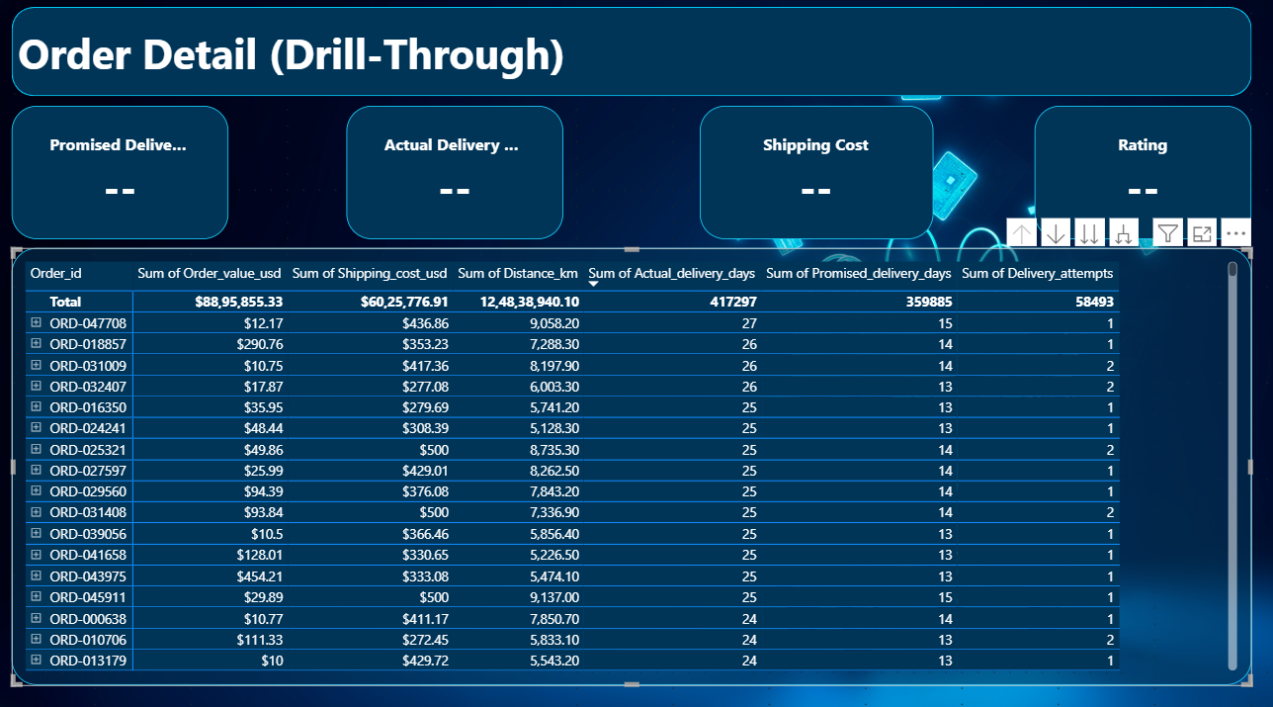
Order Detail (Drill-Through)
PAGE 6 • Right-click any chart to land on a single order
—
—
—
—
Promised Days
Actual Delivery days
Shipping Cost
Rating
Order Detail Table
Order_id • Order value (sum) • Shipping cost (sum) • Distance (sum) • Actual / Promised delivery days • Delivery attempts • Carrier • Late_delivery • Customer_id / segment / city / country
13

Slide 14
Insights
PAGE 7 (bonus) • What the numbers in the live report actually say
RISK
GAP
DRIVER
56.32% late
65.75% vs 47.34%
67.03% vs 31.48%
of all 50,000 orders arrive after the promised date — more orders are late than on time.
GlobalExpress runs the worst carrier late rate; SwiftShip the best — an 18-point gap at similar volume.
International-distance orders are more than twice as likely to be late as Local ones — the sharpest split in the report.
DRIVER
MIX
NOT A DRIVER
0.6 → 3.1 days
~58% under $100
55.75%–57.59%
Average delay swings 5x by weather, from Clear (0.6 days) up to Snow (3.1 days).
Most orders are low-ticket, yet International shipments still cost the most in aggregate.
Late rate barely moves warehouse to warehouse — carrier and distance drive lateness, not warehouse ops.
14

Slide 15
Recommended Page Order
How a viewer moves through the report
1
2
3
4
5
6
Executive Overview
Delivery Performance & SLA
Carrier & Warehouse Scorecards
Cost & Shipping Economics
Geography & Distance
Order Detail
›
›
›
›
›
Land on the headline numbers first
See where and why SLAs slip
Compare who's responsible
Check the cost trade-offs
See where it concentrates
Drill into any single order
E-COMMERCE DELIVERY ANALYTICS • DASHBOARD DESIGN
15

Slide 16
Thank you
16

